Slide 1
STUDENT PLACEMENT
Ganpat university
Prepared by : patel tirth niravkumar
Roll no. : Cse 02
Batch : 15
Subject : esfp – 1

Slide 2
USER OPTIONS…
USER CAN LOGIN.
USER CAN SING UP.
USER CAN APPLY FOR JOB’S.
USER CAN ALSO ACCESS THE TOTAL LIST OF COMPANIES AVAILABLE.
USER CAN ALSO CHECK NEWS & UPDATE’S.
USER CAN ALSO CHANGE THEIR LOGIN DETAILS.
THEY ALSO CAN KNOW US BY GOING TO ABOUT US SECTION.

Slide 3
MORE THAN 55+ COMPANIES LISTED…
APPLE
AMAZON
TATA
TESLA
SAMSUNG
HP
GANPAT UNIVERSITY
ADANI
ETC……..

Slide 4
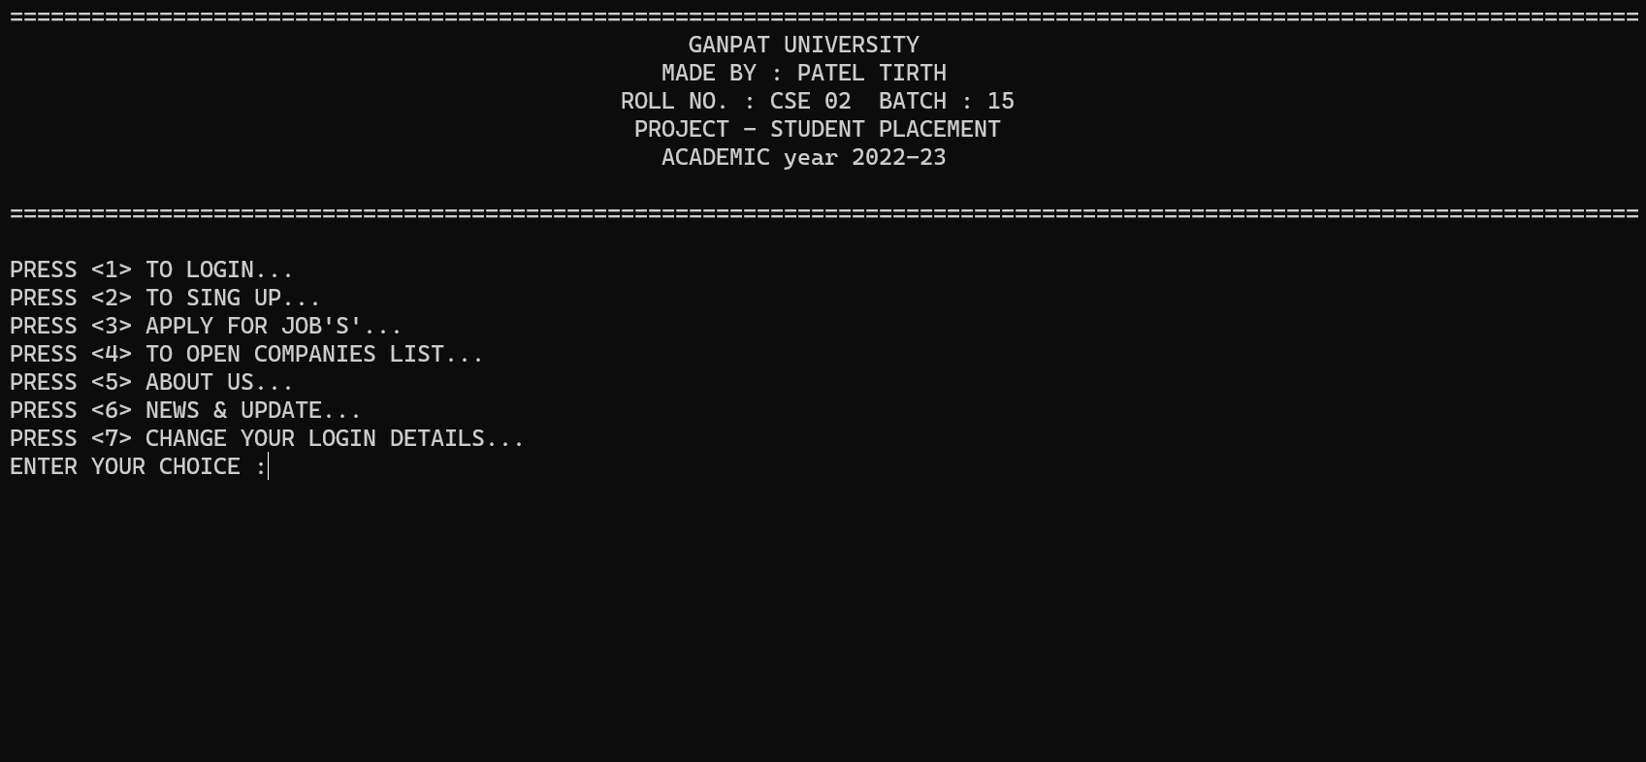
HOME PAGE…

Slide 5
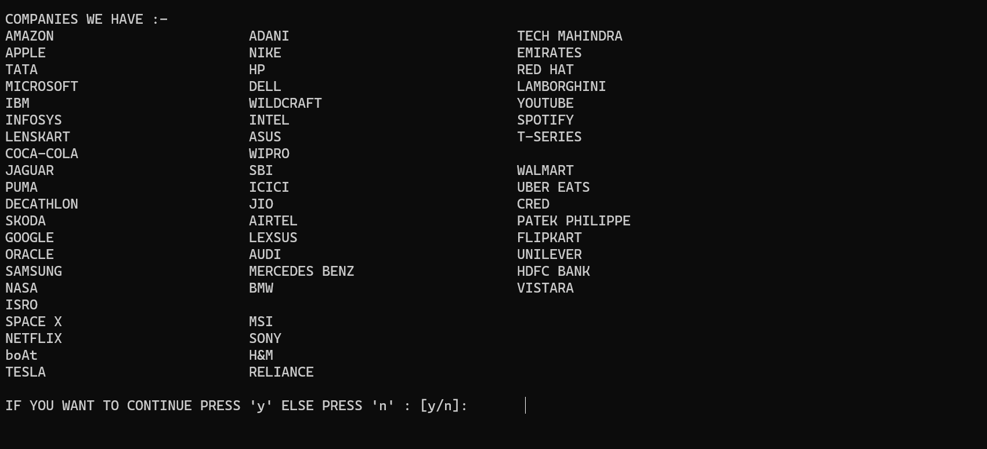
COMPANIES LIST PAGE…

Slide 6
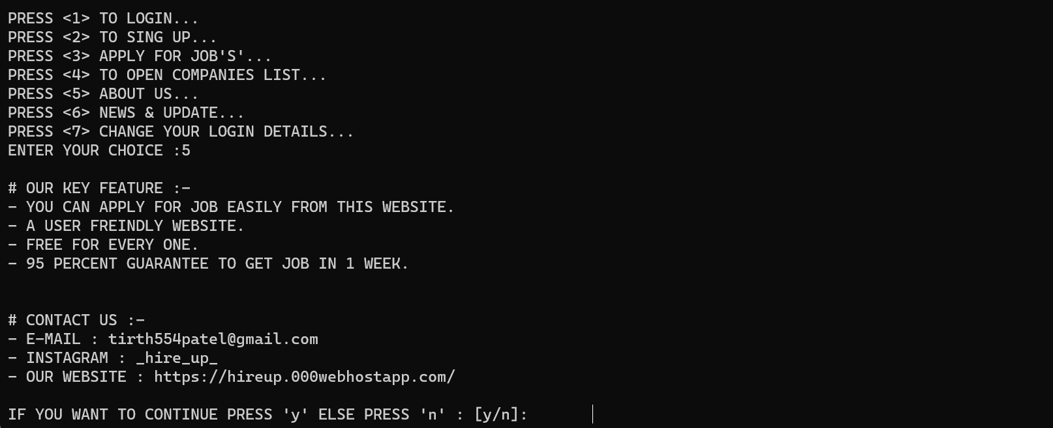
ABOUT US PAGE…

Slide 7
THANK YOU

